Slide 1

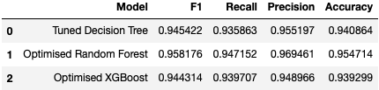
Enhancing Customer Satisfaction through Predictive Analytics
Prepared for: Invistico Airlines Senior Analyst Team
Invistico Airlines is committed to enhancing customer experience by leveraging predictive analytics. A rigorous evaluation of historical flight data was conducted to identify key drivers of customer satisfaction. Models used; Decision Tree, Random Forest and XGBoost
The primary goal is to determine significant factors influencing customer satisfaction and to refine service delivery for optimal passenger experience.
Fig: Model Comparison
The Optimized Random Forest model excels with an F1 score of 0.958, indicating a robust predictive performance.
Inflight entertainment and seat comfort surfaced as top factors impacting satisfaction, necessitating focused improvements.
Digital Experience Ease of online booking and support are critical, highlighting the demand for a seamless digital interface.
The model’s precision (0.969) underscores its efficacy in predicting satisfied customers, with opportunities to enhance recall.
Invest in Inflight Services: Priority investment in inflight entertainment and seating to directly address the primary satisfaction drivers.
Digital Transformation: Accelerate digital initiatives to streamline the online booking and support processes, boosting overall customer experience.
Notes:
Image Credits
Android Phone Icon: Created by Devendra Karkar from the Noun Project
iPhone Icon: Created by Landan Lloyd from the Noun Project

